Slide 1
Meritain Architecture North Star
TAI Systems Planning
February 2021

Slide 2


Executive Summary
Since Aetna acquisition in 2012, Meritain maintained double digits annual growth and has potential to precede goal in TPA market. Meritain’s core system DG is a legacy since early 90’s, the monolithic system build with customization over the years has become a high touch, high cost, and a brittle single point of failure for Meritain operations. In order to support the business market growth and to provide competitive service to customers, a concrete plan is needed to systemically decentralize DG and modernize Meritain’s technology stack
Opportunity
Conclusions
Recommendations
Agility: DG system (all services in one) is known to be brittle, inflexible that too big and complicate to make change in any scale w/o risk of disrupt entire business operations
Speed: DG’s massive data structure presents a huge challenge to delineate/focus on ANY business function w/o long effort from ALL teams
Cost: Increasingly difficult to maintain/replace knowledgeable person with legacy system and historical customization. New talent would require 9+ months to become proficient
TCO: Near impossible product ownership due to enormous knowledge/responsibility demand and short of investment
Meritain’s TPA offering require a fast configurable system to bring forward flexible, timely and fit-for-purpose products to market
DG cannot meet the demand of speed due to its interconnected (monolithic) nature: one must know EVERYTHING to make any change; pre-deployment testing is long and excessive that hog end-to-end resources; results are unpredictable that can cause total disruption at times
40+% claims are manually adjudicated. Even though there are potential to improve automation, the massive time/effort and the risk of total disruption is diminishing the value and deterring attempts
Identify service/data delineation inside DG, seeking opportunity to componentize business data and service capabilities
Stepped investments to commoditize portable service functions outside DG, to insulate supportability of individual service and reduce DG dependencies
Progressively remove non-core capabilities off DG to allow focused opportunity of improving auto adjudication
Enable and standardize system integrations across Enterprise, leverage Connected Platform and Cloud Strategy to modernize technology stack, with objective of improving operational efficiency and supporting long term growth
Notes:
What is the value proposition, business case - business opportunities - cost saving – risk mitigation?
What would be the potential risk if not invest? - to business, customer?

Slide 3






Where are we today ?
DG System is manual intensive to operate that cannot respond to fast and flexible business demand; emerging challenge is to decentralize system and reduce complexity, modernize technology to support business agility and speed to market
Current State
Effectiveness
Cost of Ownership
Speed to Market
Customer Experience
Innovation
Specialized IT delivery to customers and market
Low automation rate (~50%)
Slow to change due to abundant resource/time required to test end-to-end system and data
Lack standard and reusable configurability, depend heavily on customization
Bulk/batch operational maturity
Growing manual intensive operation and maintenance
Longer to ramp up new talent and replace legacy knowledge
Difficult product ownership (must know EVERYTHING)
Unaffordable DG revamp
Specialized and known to TPA market
Limited cross-sell capability
Limited data integration for improved product opportunities
Slowness and costly legacy system waning business competitiveness and impact Total Cost of Care
Digital engagement and support self-services
Limited mobile capability, lack Preference and Consent customer channels (text, email, etc.)
No omni-channel
Limited enterprise visibility to support customer service
Net Promoter Score to benchmark?
Pilot decentralizing efforts
Lack endorsed roadmap and investment
Limited integration to leverage and realize enterprise opportunities (i.e. Isolated member book of record)

Slide 4

Where are we today?
Impact of legacy DG: longer system change cycle, higher demand on manual resources, increasing risk to customer experience, lower opportunity to automate, poor business agility
Problem of Monolithic
DG
Slower respond to market & competition
Increasing process complexity and negatively impact Total Cost of Care
Risk of service disruption and poor customer experience
Claims Audit
Customer Service
Visible
WEB
Claims Feeds
IVR
Remittance
ACO Administration
27x support
837 import
Group Setup
Eligibility Feeds
Claims Adjudication
Retiree
Eligibility
Cannot improve auto adjudication
Surging manual works and increasing demand of knowledgeable resource
Longer talent ramps up time and harder to maintain legacy knowledge
Growing technical debt
Difficult to support operational goals with unpredictable system SLA
Possibility of missing new business opportunities
…
Plan Build
Correspondence
Invisible
Cobra
FI Schedule of Benefits
Reporting
Finance
Commissions
Document
Image
etc.
Billing
Claims letters
Invisible

Slide 5
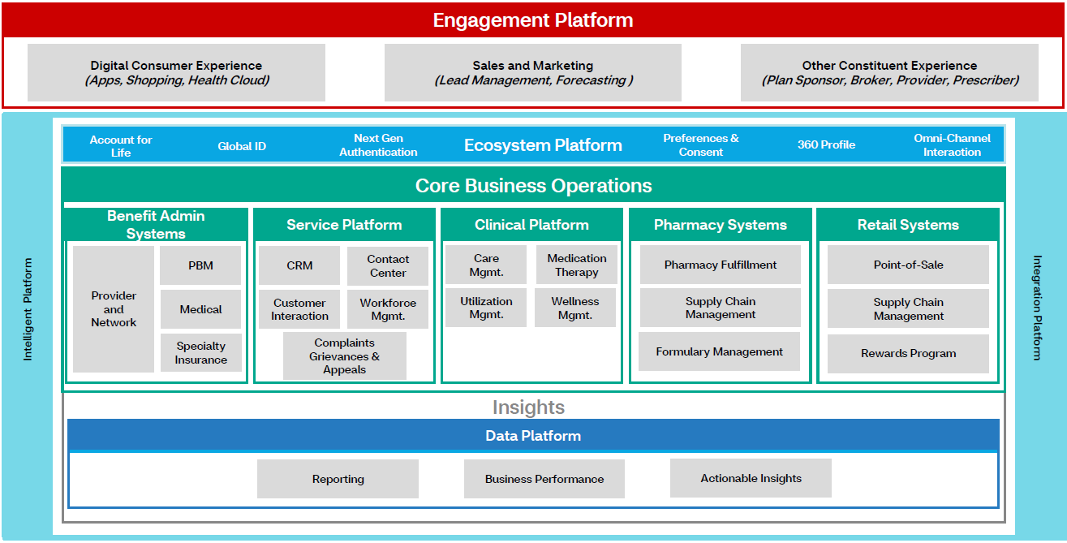
CVS Connected Platform Landscape and Focus
The Connected Platform Strategy currently focus on Enterprise Data Platform (EDP), Service Platform, Intelligent Platform, Ecosystem Platform and Clinical platform
2021 Goals
Leverage Enterprise capability to drive service & growth
Invest in technology to simplify process & connect customers
Deliver integrated experience and lower total cost of care
Bringing differentiated products to deliver customer value
Develop talent and reflect diversity
Modernize business to connect constituents, and invest in long-term opportunities
Notes:
Engagement ` Health Cloud/EDAP (Enterprise Digital Application Platform)

Slide 6
How does Meritain Align with the Company Goal?
Strategic investments are foundational to align with CVS strategy and deliver a decentralized technology stack that enable business agility, advance speed to market and optimize customer experience
Investment | Description | Impact
Redirect (CSR call from Aetna to Meritain) | Integrate Global ID to recognize Meritain members (even w/o Aetna affiliation) for friendly service transfer | Simplified customer experience Optimize service process by leveraging ecosystem technology
PWA (Enable mobile to MeritainConnect) | Expand digital accessibility to mobile, using fast and low-cost technology | Provide Meritain customer with mobile accessibility
Real-time Repricing | Leverage existing Enterprise API to return over 80% of Meritain claims repriced in real-time | Reduce non-value-add vendor cost Boost operation turn around time (48hr vs. seconds) Simplify business process to improve efficiency
DG Resiliency (Build fast and scaled recoverability) | Replicate a set of customer-facing applications to enable fast fail-over during DG outage, reduce impact to external customers | Deliver customer service SLA commitment Polit MVP step toward decentralizing legacy system
Tech. Modernization (Commoditize Correspondence, Document Image, etc. Reduce DG dependency, Improve products and integrations) | Strategic steps toward decentralized tech stock: Commoditize non-core services like Correspondence Enable API and data modeling for business products Leverage cloud opportunity, retire old assets | Simplify legacy system operation to create speed Reduce manual work for better efficiency Improve automation opportunity and business agility
Data Insight (Real-time access, support cross-sell, EDP* integration) | Unlock the hidden value of data across-Enterprise Enhance real-time service experience and expand business opportunity of cross-selling | Improve quality and speed of services operations Support revenue growth opportunities Integrate enterprise technology to improve efficiency
Digitization (On demand messaging, enrich web/mobile service, leverage Service/Intelligent platform) | Build on demand message channels (Text, email, etc.) Engage personalized consent across digital enablement Advance analytical to drive Omni-channel opportunity | Expand digital channels and leverage intelligent technology to deliver seamless customer experience, Improve compliance and enhance services
We took initial steps
In-flight Initiatives
Forward steps to drive long-term objectives
*EDP: Enterprise Data Platform
Notes:
Doc mgmt to cloud (filenet)
History: example use technology and integration to improve service
Current: small step to invest future
Long term: these investment to close gaps and move toward long term strategy

Slide 7






What does Success look like?
Meritain’s TPA product is a key component to CVS diversified health service model. It brings flexible, one-stop-shop accessibility to a broader consumer base that enable our purpose of helping people on their path to better health
Our Strategic Imperatives
Start with the consumer …
… to transform our business and industry.
Be local
Engage people with the care benefit they need where they need it
Lead the change
Challenge the status quo with new technologies, business models and partnerships
Attract and inspire
Unlock the power of our people to transform health care
Optimize performance and service
Ensure our people, processes and technology enable our strategy
Make it simple
Make a complicated system easier for all
Improve health
Help people achieve better health at a lower cost
Deliver Expectation
Develop fit-for-purpose products and offering to market, maximize outreach to people at need
Digitalization
Enrich digital means and simplify customer engagement.
Steadily tackle system complexity and improve automation
Data Insights
Enhance data analytical speed and aim personalized Next Best Action.
Leverage Connected Platform* and reduce Total Cost of Care
Modernization
Drive cloud adoption thro decoupling, reengineering and integration.
Elevate cross sell opportunity and optimize investment
Foster Culture
Fortify cross team synergies and diversify collaboration.
Cultivate cohesive environment, strive for excellence
Rationalization
Adopt SAFe to build configurable system and improve performance. Retire old assets, invest in customer value and improve
Net Promoter Score
How We Differentiate
*CVS Connected Platform Strategy focus: Enterprise Data Platform (EDP), Service, Intelligent, EcoSystem and Clinical platforms

Slide 8

Necessary Actions - Recommendations
Big bang migration approach is not recommended, Meritain should take small steps to progressively stabilize and advance operational capabilities by implementing a componentized platform to maximize flexibility and improve speed to market
Roadmap
Resilience
Componentize
Integrate
Agility
Existing
New
Modified
Current state
All-in-one = single point of failure
Downtime immediately disrupts customers and all operations
Slow to change ANYTHING, since must touch EVERYTHING
Recoverability
Build customer-facing service outside DG to reduce disruption
Identify non-claim data/systems for potential remove off DG
De-couple
Commoditize and remove non-core services from DG 1-by-1
Bring operational data outside DG to reduce dependency
Integration
Standardize cross system integration to optimize speed
Maximize automation to gain efficiency and business agility
UI
DG:
Services + Data
UI
DG:
Services + Data
UI
Integration
UI
Integration
Customers
Service
Service
DG:
Services + Data
Ext. service
Service
Service
Service
Service
Core Services

Slide 9

Next Steps
With consistent investment and SAFe practice, Meritain can advance consistently by milestones to build a decentralized technology stack that enable long-term business value objectives
Leadership
Near-Term Action
(2021)
Long-Term Action
(2022 forward)
IT
Deliver a fast recovery capability of external-facing services and minimize customer disruption
Identify milestone prospects to componentize DG, collaborate business value roadmap and evangelize for budget
Adopt SAFe to identify and organize system, people to realize value stream deliverables
Timely retire old assets / process to free up resources
Align Connected Platform Strategy and leverage broad capabilities at all opportunities
Establish Agile teams to deliver milestones per value streams, start with MVP
Continue with incremental and ‘cloud first’ approach to attack individual service component and progressively achieve objectives
Track strategic initiatives in enterprise and seeking opportunity to collaborate, share and leverage, in order to reduce overall cost and deliver an integrated experience
Business
Endorse technology investment
Identify business opportunity value streams to charter improvements
Take executive sponsorship to support execution
Commitment to funding and partnership in delivery of business result

